Slide 1
OSI Model

Slide 2
Layer Architecture
Layer architecture simplifies the network design.
It is easy to debug network applications in a layered architecture network.
The network management is easier due to the layered architecture.
Network layers follow a set of rules, called protocol.
The protocol defines the format of the data being exchanged, and the control and timing for the handshake between layers.

Slide 3
Open Systems Interconnection (OSI) Model
International standard organization (ISO) established a committee in 1977 to develop an architecture for computer communication.
Open Systems Interconnection (OSI) reference model is the result of this effort.
In 1984, the Open Systems Interconnection (OSI) reference model was approved as an international standard for communications architecture.
Term “open” denotes the ability to connect any two systems which conform to the reference model and associated standards.

Slide 4
OSI Reference Model
The OSI model is now considered the primary Architectural model for inter-computer communications.
The OSI model describes how information or data makes its way from application programmes (such as spreadsheets) through a network medium (such as wire) to another application programme located on another network.
The OSI reference model divides the problem of moving information between computers over a network medium into SEVEN smaller and more manageable problems .
This separation into smaller more manageable functions is known as layering.

Slide 5
OSI: A Layered Network Model
The process of breaking up the functions or tasks of networking into layers reduces complexity.
Each layer provides a service to the layer above it in the protocol specification.
Each layer communicates with the same layer’s software or hardware on other computers.
The lower 4 layers (transport, network, data link and physical —Layers 4, 3, 2, and 1) are concerned with the flow of data from end to end through the network.
The upper four layers of the OSI model (application, presentation and session—Layers 7, 6 and 5) are orientated more toward services to the applications.
Data is Encapsulated with the necessary protocol information as it moves down the layers before network transit.

Slide 6
Open Systems Interconnection (OSI) is a set of internationally recognized, non-proprietary standards for networking and for operating system involved in networking functions.

Slide 7
7 Layers
7. Application Layer
Presentation Layer
Session Layer
Transport Layer
Network Layer
Data Link Layer
Physical Layer
All
People
Seem
To
Need
Data
Processing

Slide 8

Tasks involved in sending letter

Slide 9
LAYER 7 – The APPLICATION Layer
The top layer of the OSI model
Provides a set of interfaces for sending and receiving applications to gain access to and use network services, such as: networked file transfer, message handling and database query processing

Slide 10
The application layer is responsible for
providing services to the user.

Slide 11
LAYER 6 – The PRESENTATION Layer
Manages data-format information for networked communications (the network’s translator)
For outgoing messages, it converts data into a generic format for network transmission; for incoming messages, it converts data from the generic network format to a format that the receiving application can understand
This layer is also responsible for certain protocol conversions, data encryption/decryption, or data compression/decompression
A special software facility called a “redirector” operates at this layer to determine if a request is network related on not and forward network-related requests to an appropriate network resource

Slide 12
The presentation layer is responsible for translation, compression, and encryption.

Slide 13
LAYER 5 – The SESSION Layer
Enables two networked resources to hold ongoing communications (called a session) across a network
Applications on either end of the session are able to ex hange data for the duration of the session
This layer is:
Responsible for initiating, maintaining and terminating sessions
Responsible for security and access control to session information (via session participant identification)
Responsible for synchronization services, and for checkpoint services

Slide 14
The session layer is responsible for dialog
control and synchronization.

Slide 15
LAYER 4 – The TRANSPORT Layer
Manages the transmission of data across a network
Manages the flow of data between parties by segmenting long data streams into smaller data chunks (based on allowed “packet” size for a given transmission medium)
Reassembles chunks into their original sequence at the receiving end
Provides acknowledgements of successful transmissions and requests resends for packets which arrive with errors

Slide 16
The transport layer is responsible for the delivery
of a message from one process to another.

Slide 17
LAYER 3 – The NETWORK Layer
Handles addressing messages for delivery, as well as translating logical network addresses and names into their physical counterparts
Responsible for deciding how to route transmissions between computers
This layer also handles the decisions needed to get data from one point to the next point along a network path
This layer also handles packet switching and network congestion control

Slide 18
The network layer is responsible for the
delivery of individual packets from
the source host to the destination host.

Slide 19
LAYER 2 – The DATA LINK Layer
Handles special data frames (packets) between the Network layer and the Physical layer
At the receiving end, this layer packages raw data from the physical layer into data frames for delivery to the Network layer
At the sending end this layer handles conversion of data into raw formats that can be handled by the Physical Layer

Slide 20
The data link layer is responsible for moving
frames from one hop (node) to the next.

Slide 21
LAYER 1 – The PHYSICAL Layer
Converts bits into electronic signals for outgoing messages
Converts electronic signals into bits for incoming messages
This layer manages the interface between the the computer and the network medium (coax, twisted pair, etc.)
This layer tells the driver software for the MAU (media attachment unit, ex. network interface cards (NICs, modems, etc.)) what needs to be sent across the medium
The bottom layer of the OSI model

Slide 22
The physical layer is responsible for movements of
individual bits from one hop (node) to the next.

Slide 23
Remember
A convenient aid for remembering the OSI layer names is to use the first letter of each word in the phrase:
All People Seem To Need Data Processing

Slide 24
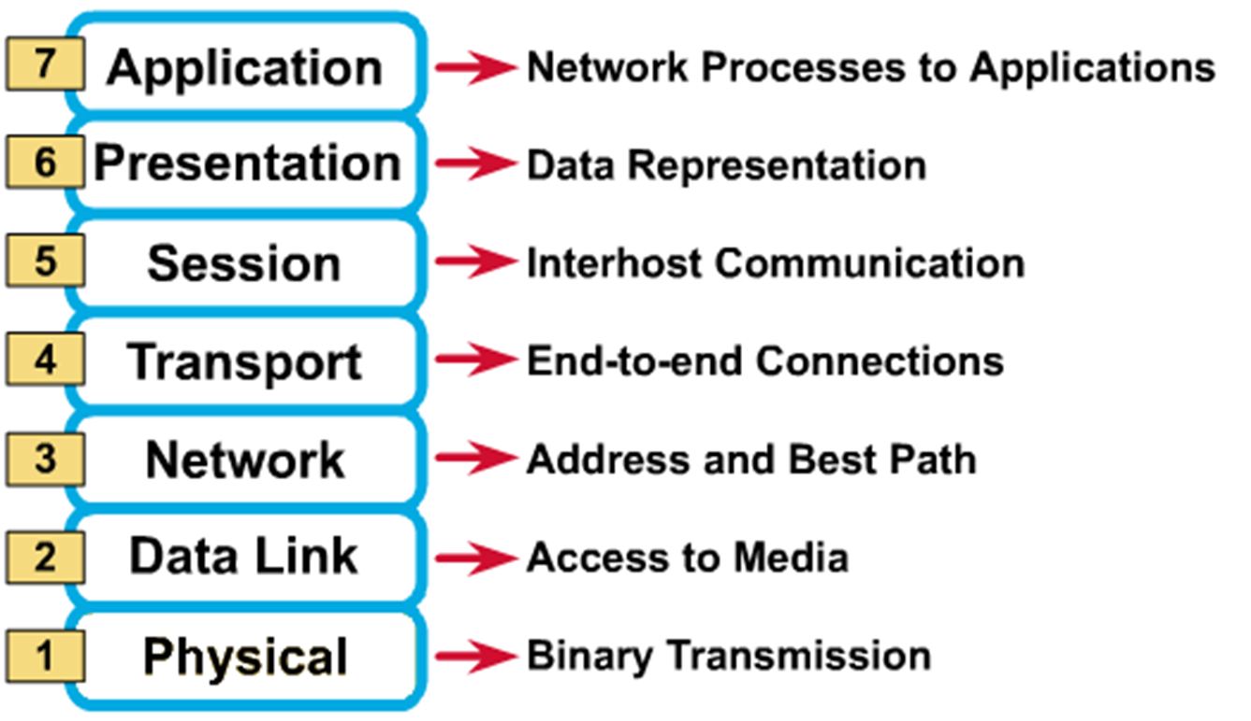
OSI Reference Model: 7
A convenient aid for remembering the OSI layer names is to use the first letter of each word in the phrase:
All People Seem To Need Data Processing

Slide 25


